Slide 1
What Data do we have
Sarah Tamayo, P.E.
2019 TRC Transportation Conference & Equipment Expo
Hot Springs, AR
Notes:
**** Additions made by Sig are indicated by four asterisks. ****

Slide 2
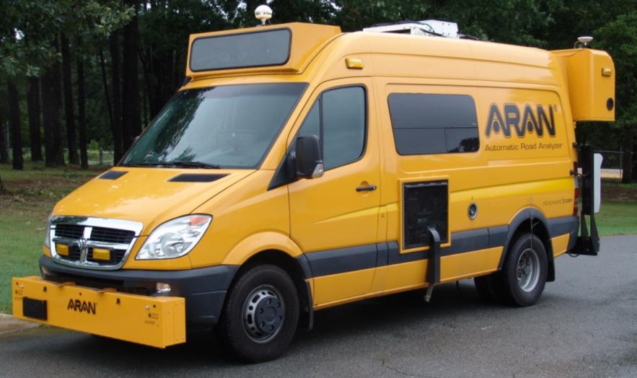
Current Data Collection Vehicle
Notes:
Before I go into what data we have available, I want to talk to you a little about our data collection it self. As a lot of you know our current data collection vehicle is reaching the end of its life

Slide 3
New data collection vehicle
Notes:
Good news is we have a new data collection vehicle coming soon!!
The big change with the new vehicle is that we will be going from 2D crack collection to 3D crack collection. This should make our cracking detection more accurate.
It will probably be 6 months before we have our new data collection vehicle up and running.
Once we have our new vehicle there will be several things we need to do in the conversion and that will take time to get things up and running.
So please be patient with us.

Slide 4
To add to the confusion
Old school way
ARDOT way
FHWA way
Notes:
Along with the new vehicle and crack detection equipment we also have new performance measures from FHWA.
Back in the day, we use to show pavement condition solely based on IRI.
Currently ARDOT uses a PCI (pavement condition index) to determine the condition of the system. **** This is scale of 0-100. ****
We take the IRI, Rutting, Cracking, and Faulting values and plug them into equations and that determines the PCI.
This is a more accurate representation of the actual condition of the network.
FHWA has set values for IRI, Rutting, Cracking, and Faulting to determine if each individual metric is good, fair, or poor.
If all 3 metrics are good, then the pavement is good. If 2 or more of the metric are poor, then the pavement is poor. Everything else is fair.

Slide 5
NHS pavement condition
Notes:
This is the condition of the national highway system in Arkansas.
As you can see from this chart, all 3 systems measure the condition of the pavement differently.
We no long use the IRI-only system but if you come across older pavement condition data or maps that may be the difference.
You may be wondering why I’m taking time in this presentation to explain all these measuring systems.

Slide 6
NHS pavement condition
Notes:
The answer is because we need to use two different systems.
If you want to know the condition of the network, you will need to use the PCI system. **** Sometimes the 0-100 index value is converted into letter grades (A,B,C,D & F) and we call this the Pavement Condition Rating (PCR). ****
When you want to select treatments the meet the preventive maintenance agreement you will be using the federal system (good, fair, poor).
My current plan is to give each of the districts 2 maps/data bases, but I would like the districts input on this.

Slide 7
Arkansas – Thresholds and Distresses
Notes:
Here is a comparison of what goes into the Federal rating vs ARDOTS PCI.
As you can see, ARDOTs PCI takes a lot more cracking into account then the federal requirements.

Slide 8
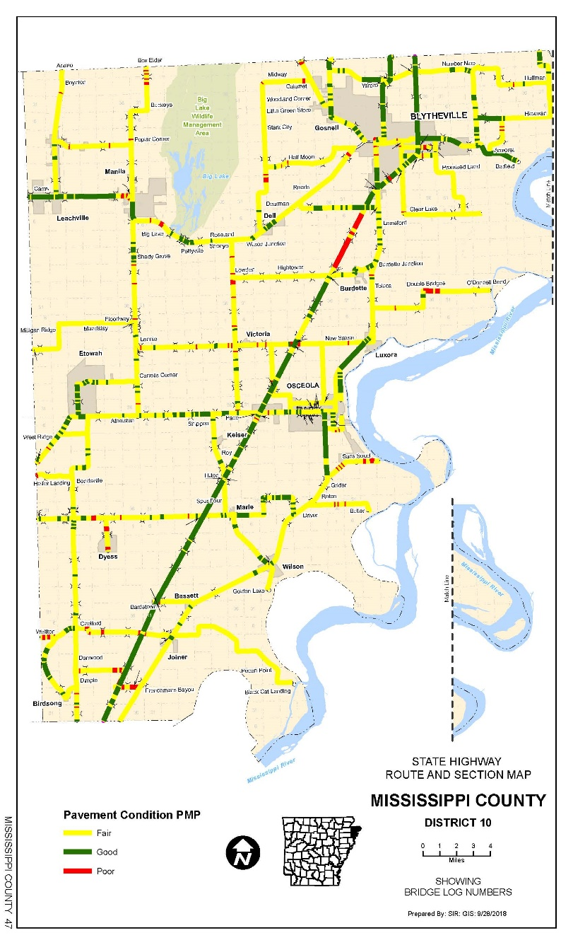
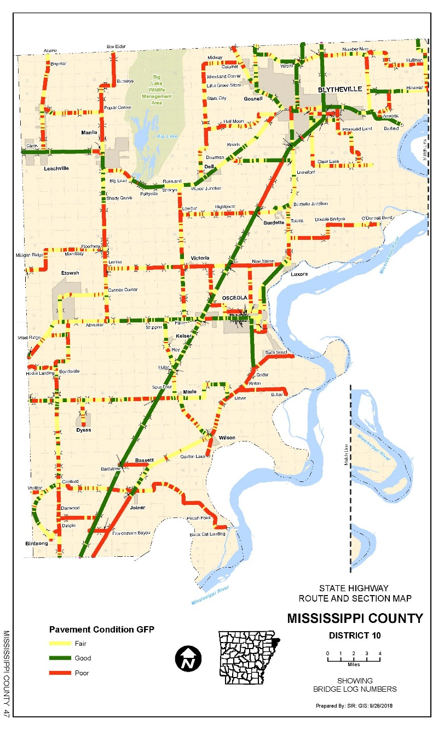
Pavement Condition—Federal Measurements
Pavement Condition—Internal Measurements
Notes:
So this is what the difference between the 2 systems looks like graphically.
The federal (good, fair, poor) map is on the left and ARDOTs PCI map is on the right.
This is the best example because we have converted the grading scale to good, fair, poor. To reduce confusion we are planning on keeping ARDOTs PCI in grades and the Federal System in (good, fair, poor).

Slide 9
Our cheat sheet for pavement condition
Notes:
Once we get the bugs worked out with this, Asset Management will make this tool available others at the Department.
I do not currently have an estimated completion date, but if you need the condition of a roadway just call or email me and I will get it to you.

Slide 10
Our cheat sheet for pavement condition
Notes:
How this works is:
You enter the route, section and log miles.

Slide 11
Our cheat sheet for pavement condition
Notes:
And it will spit out average IRI and rutting for the section.

Slide 12
Our cheat sheet for pavement condition
Notes:
Along with ARDOTs PCI/PCR

Slide 13
Our cheat sheet for pavement condition
Notes:
And the federal good, fair, poor

Slide 14
10th mile data vs pavement management segments
Notes:
The maps I showed earlier and the rating systems are based on 10th mile data, which, when you are looking at the whole network, is a lot of data.

Slide 15
Arkansas - Segments

Slide 16
Arkansas - Segments
Notes:
What I had originally used this slide for was to demonstrate the difference between the federal (good, fair, poor) and ARDOTS grading scale, but that’s not why this slide is here. Hopefully I’ve already explained the differences to you.
Asset Management is currently working on establishing permanent pavement management sections to make pavement management analysis more consistent. It will also have the added benefited of no one having to constantly come up with job termini and we will be able to avoid the gaps between jobs.
We will need the districts help with this. Once we have completed the pavement management sections we would like each of the districts to review them.
This is a big task but I think once it is done it will make things easier for everyone who deals with project selection and maintenance.

Slide 17
Treatment selection

Slide 18

Notes:
Once you have your data and the project limits have been selected,
How are you going to pick your treatment?

Slide 19
Decision Tree
Under Construction
Notes:
We are currently working on a decision trees for pavement preservation!

Slide 20
Decision tree - Asphalt
Notes:
We do have a draft decision tree for asphalt pavement. It still needs some tweaking and approval from upper administration. I’m hoping to have this ready sooner rather than later.
One thing we need from the district is your ADT cut off for chip seals. We still haven’t heard from four districts. I’m not going to call you our right now but I will try and track you down this week.

Slide 21
Wrap up
We will get you 10th mile pavement condition maps soon
Change is coming
  We are working on pavement condition tool
  We are working on decision trees
We will need
  Your input throughout the process
  Your patience while we try and get everything into place

Slide 22
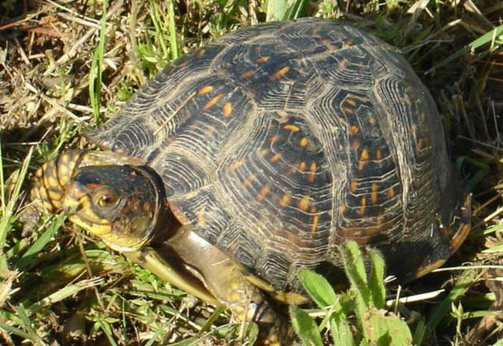
Questions?

